Slide 1

E-WASTE
-INVENTORY MANAGEMENT

Slide 2
Team members
P.SAI PRANAY | 2110030034
V.AKSHAY | 2110030246
ANUDEEP | 2110030260
M.SINDHURA | 2110030314
S.NIKHITHA | 2110030320
B.AKSHAYA | 2110030345
K.GOUTHAMI MANOHARI | 2110030375
K.DHANA SREE | 2110030444

Slide 3
















01
WHAT IS E-WASTE
02
HISTORY
03
TYPES OF E-WASTE
04
EFFECTS OF E-WASTE
CONTENTS
05
STATISTICS OF E-WASTE
06
DATA SECURITY
07
SOLUTIONS

Slide 4








08
METHODS OF DISPOSAL
09
E-WASTE RECYCLING
10
E-WASTE MANAGEMENT
CONTENTS
11
CONCLUSION
12
REFERENCES
11

Slide 5
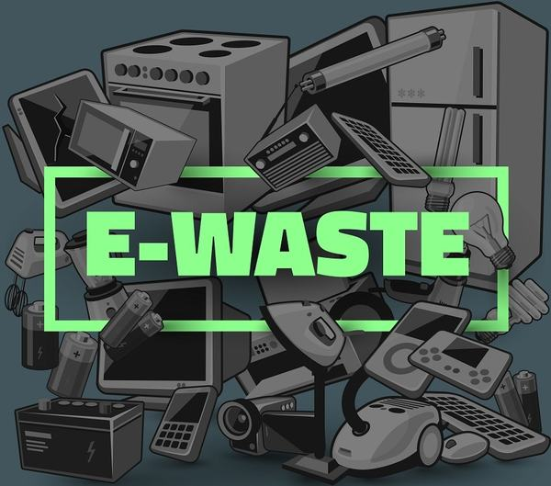
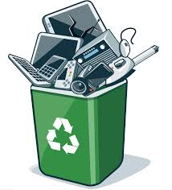
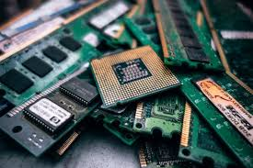
1. WHAT IS E-WASTE?
Abbreviation of "electronic and electrical waste".
Scrap produced from discarded electronic devices.
Includes working and broken items that are thrown
in the garbage.

Slide 6
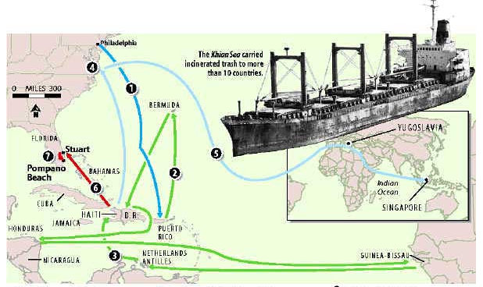
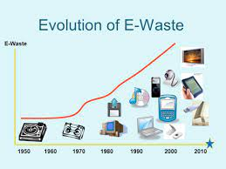
2. HISTORY OF E-WASTE
“Resource Conservation And Recovery Act”(RCRA),
The first step taken toward organizing e-waste was enacted in 1976 by the US government.
KHAIN SEA INCIDENT.
‘GOLDEN PERIOD’
1984 and 1990, the period of continuous and rapid growth in the electronics industry.

Slide 7
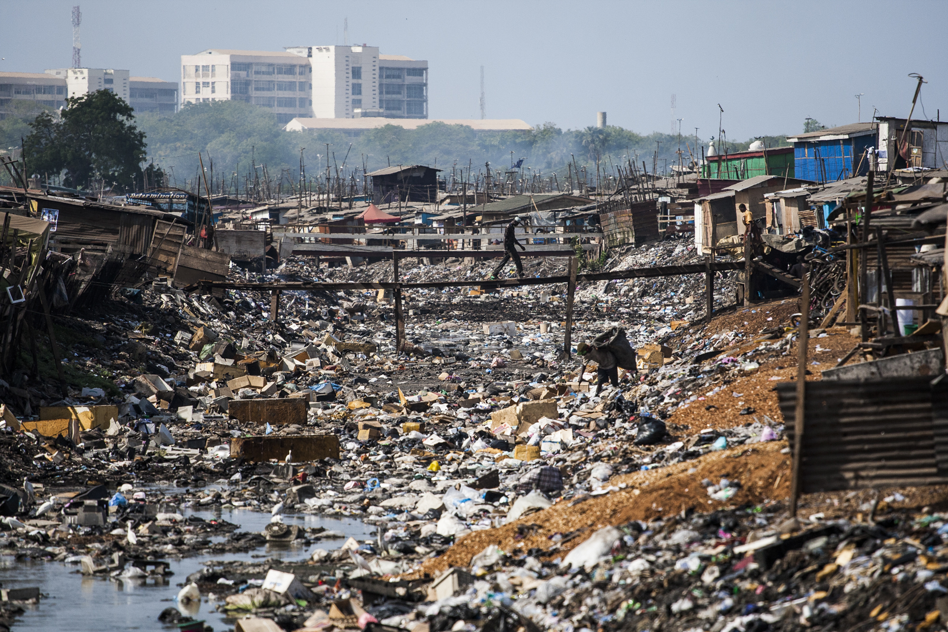
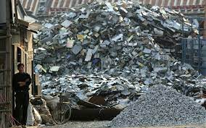
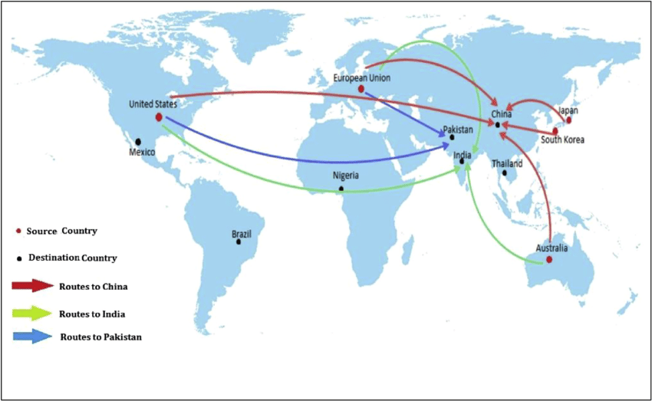
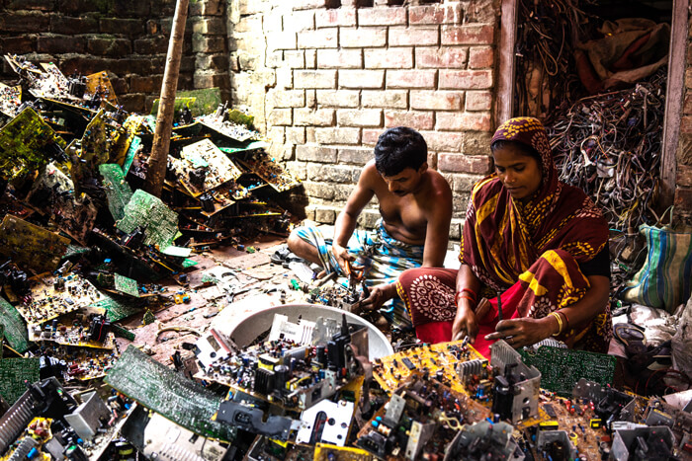
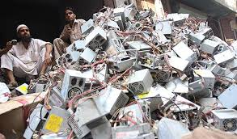
Ghana(Africa)
Guiyu(China)
E-waste dumping routes
Delhi(India)
Karachi(Pakistan)

Slide 8
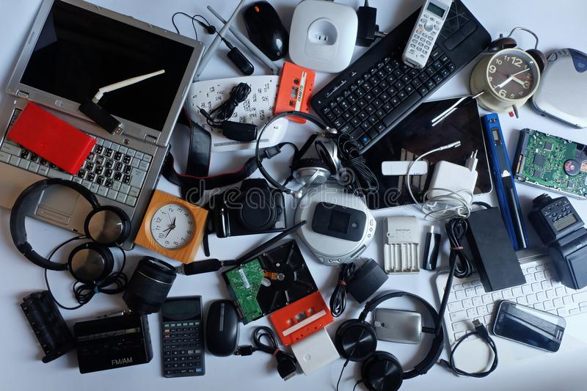
3. TYPES OF E-WASTE

Slide 9
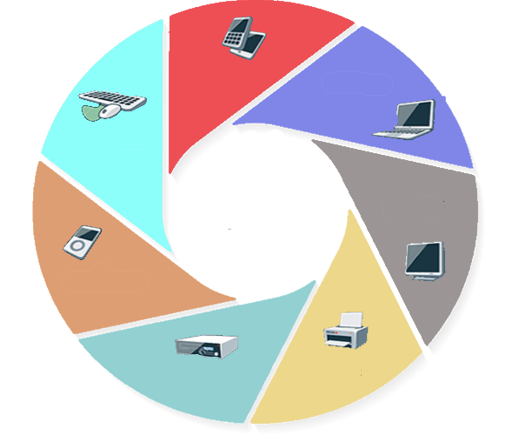
MOBILES
LAPTOPS
PRINTERS
HARD DRIVES
CORDS
CABELS
WIFI-DONGELS
REMOTE CONTROLS
SMART LAMPS
SMART WATCHES
GADGETS
OFFICE
EQUIPMENTS
ELECTRONIC
UTILITIES
TYPES OF
E-WASTE
ENTERTAINMENT
DEVICES
AIR COMPRESSOR
HAMMER DRILL
DVD’S
STEREOS
TELEVISION
VIDEOGAME SYSTEM
POWER TOOLS
HOME
APPLIANCES
MEDICAL
EQUIPMENTS
CORDS
CABELS
WIFI-DONGELS
MICROWAVE
FANS
HEATERS

Slide 10
E-Waste is one of the fastest-growing streams on the planet.
India is 3rd largest E-Waste producer.
Only 12.5% of E-Waste is currently recycled.
E-Waste accounts for 70% of toxic waste production.
20 to 50 million metric tons of E-Waste are disposed
worldwide every year.
Recycling E-Waste uses far less energy than mining virgin ore for new metals.
DID YOU KNOW??

Slide 11
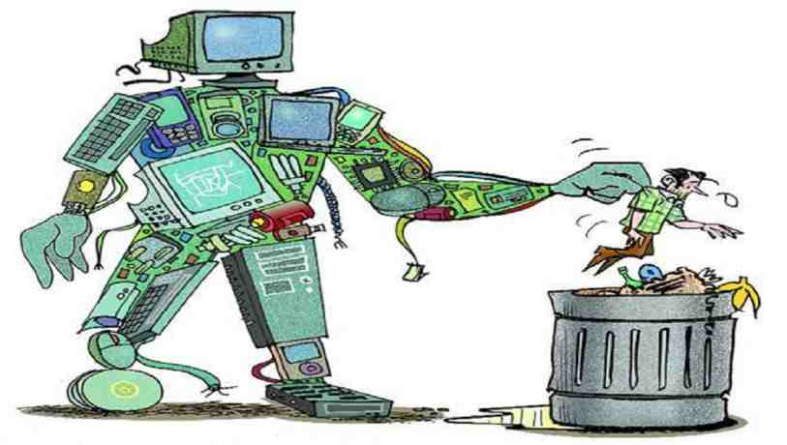
4. EFFECTS OF E-WASTE
1. EFFECTS ON HUMAN
2. EFFECTS ON THE ENVIRONMENT
Hazardous
Non hazardous
Lead
Mercury
Sulphur
Cadmium
Beryllium oxide
Aluminium
Copper
Germanium
Gold
Iron
Silicon
Tin
Zinc

Slide 12
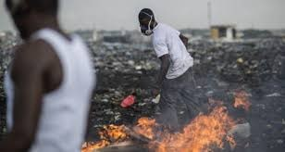
4.1. EFFECTS ON HUMAN
Respiratory diseases.
Disproportionate neurological damage.
Kidney and skeletal system damage.
DNA damage , impaired thyroid function.
Increased risk of some chronic diseases, such as Cancer and Cardiovascular disease.

Slide 13
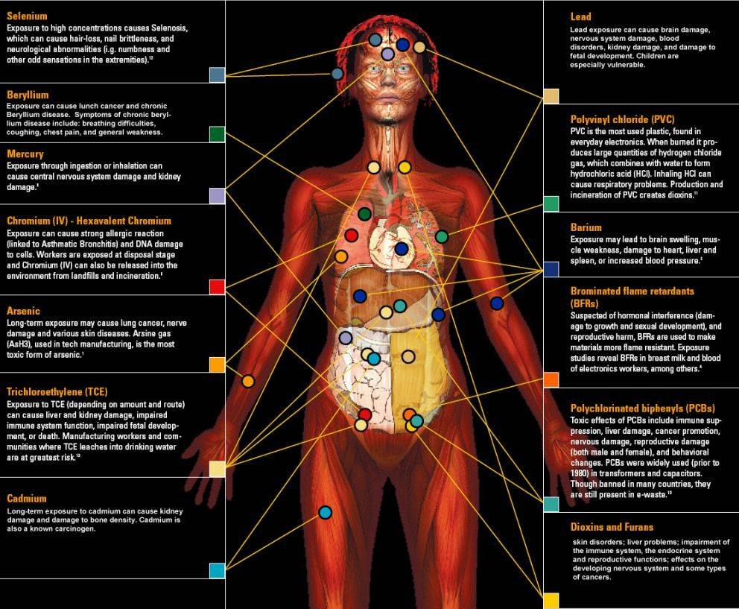

Slide 14
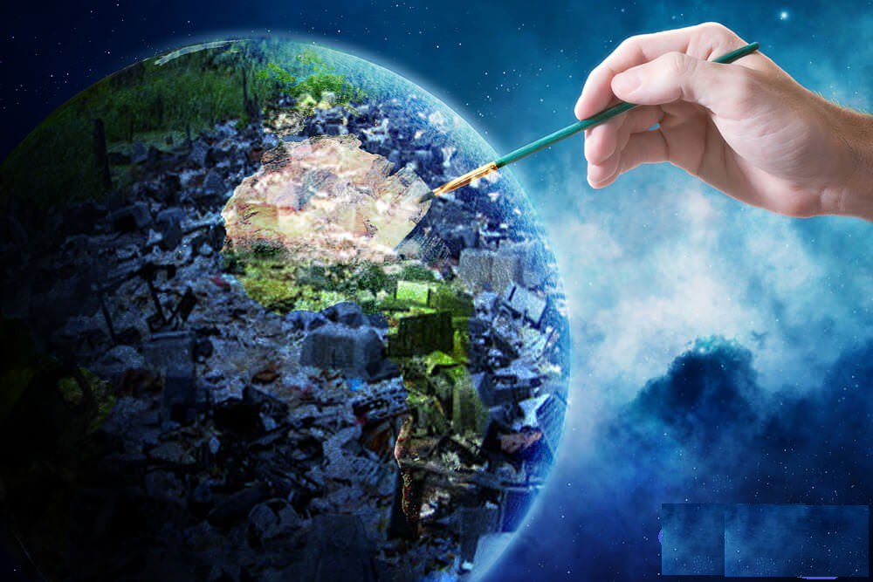
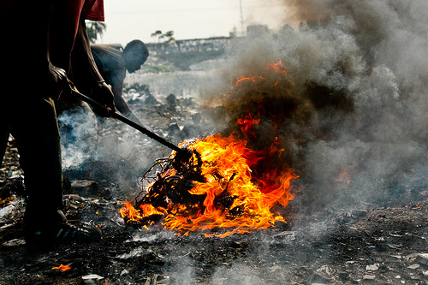
4.2. EFFECTS ON ENVIRONMENT
Contamination in air.
Adulterant of soil.
Acidification and noxious are created in the water.
Increase PH levels of resources.
Disturb biodiversity and harm ecosystems.
Cause Leaching.

Slide 15
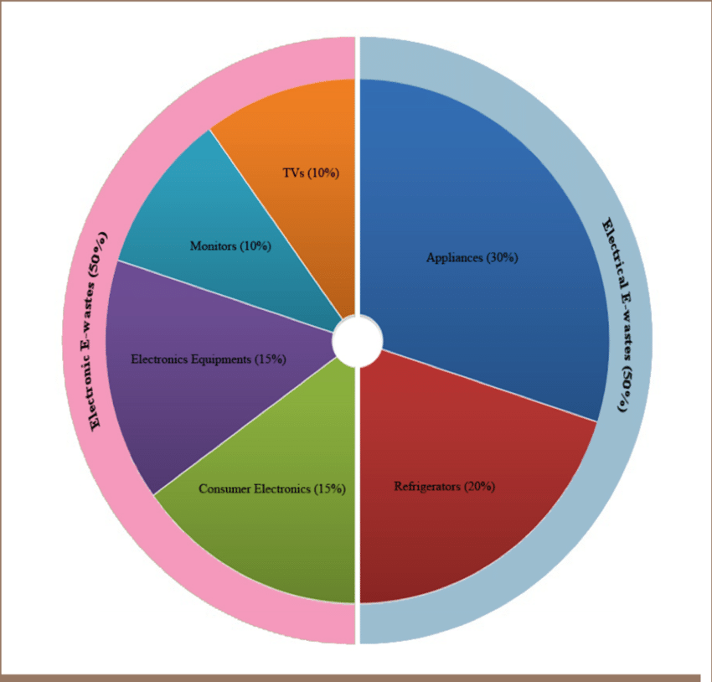
5. Statistics
In India, Mumbai ranks first in generating e-waste
followed by Delhi, Bangalore, Chennai.
As per the Material Recycling Association(MRAI),
India’s recycling rate stands at 30%.

Slide 16
E-Waste generated and recycled
2011-2013
The E-Waste growth rate from
2007-2021
Countries with most
E-Waste production

Slide 17


6. Data Security
Phishing scams are the biggest security threat.
Critical documents and serial numbers need to be
shredded before you throw them out.
Hard drive inside your computer or the memory
stick inside your smartphone is a significant liability.

Slide 18
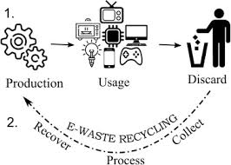
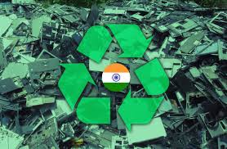
7. SOLUTIONS
4Rs
Reuse, Reduce, Recycle, Repair
Give back to your electronic companies and drop-off points.
example: Tech Collect, E-Cycle Solutions, etc.
Proper methods of disposal.
Buy environment-friendly electronics.

Slide 19
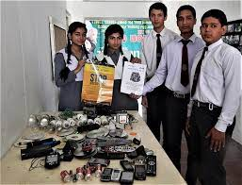
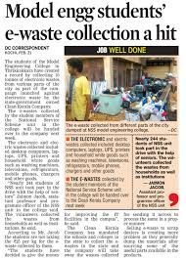
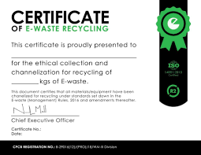
7.1. role of student
Students can contribute to the following :
Producing fewer wastes.
Keeping classrooms and households clean.
Helping in disposing of wastes.
Discussions and debates.
Creativity to reuse E-waste.
Presentations.
Social Awareness .

Slide 20
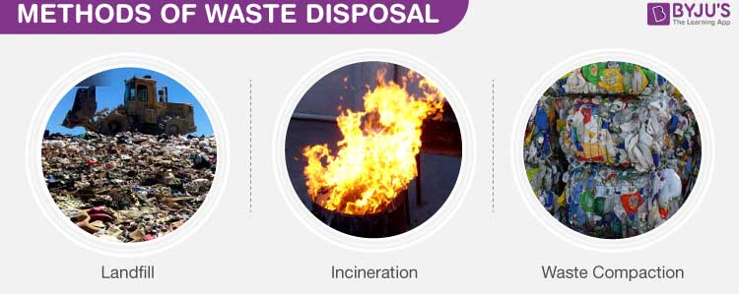
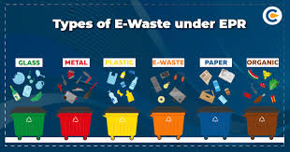
8. METHODS OF DISPOSAL
Competitive Landscape
Give back to your electronic companies
and drop-off points.
Donate or sell your outdated technology.
Give your electronic waste to a certified E-Waste recycler.
Use cloud services to store data.

Slide 21
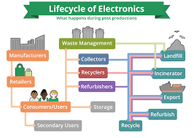
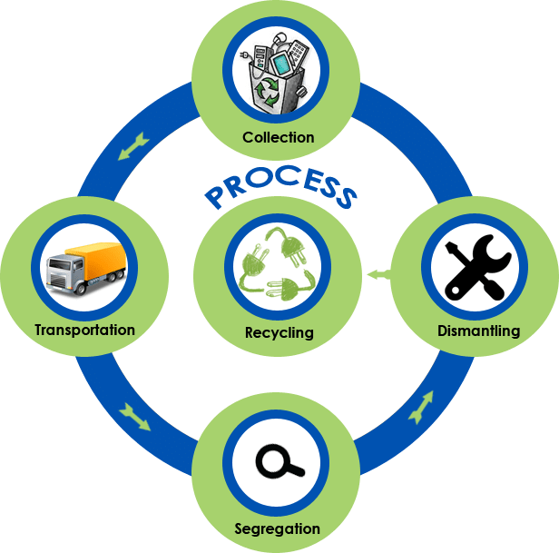
9. PROCESS OF E-WASTE RECYCLING
STEP-1 Collecting and Transporting
STEP-2 Shredding and Sorting
STEP-3: Dust Extraction
STEP-4: Magnetic Separation
STEP-5:Water Separation
STEP-6: Purification of Waste stream
STEP-7:Preparing recycled materials for sale

Slide 22


COLLECTING
AND TRANSPORTING
SHREDDING
AND
SORTING
DUST EXTRACTION
Smoothly spread e-waste pieces get broken down
Initializing take-back booths and collection booth to collect e-waste
Breaking e-waste into smaller pieces for proper sorting by using hand
MAGNETIC SEPARATION
Strong overhead magnet helps to separate steel and iron from other wastes
RECYCLED MATERIALS FOR SALE
WORKSHOP
WATER SEPARATION
PREPARING RECYCLED MATERIALS FOR SALE
PURIFICATION OF WASTE STREAM
Used to separate the glass from the plastic
Locating and extracting leftover metals from plastic to purify the waste stream further

Slide 23
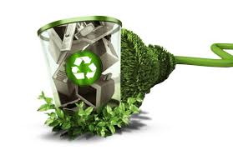
ADVANTAGES OF RECYCLING
Reduced landfills
Asset recovery
Resale and reuse
Creation of Jobs

Slide 24
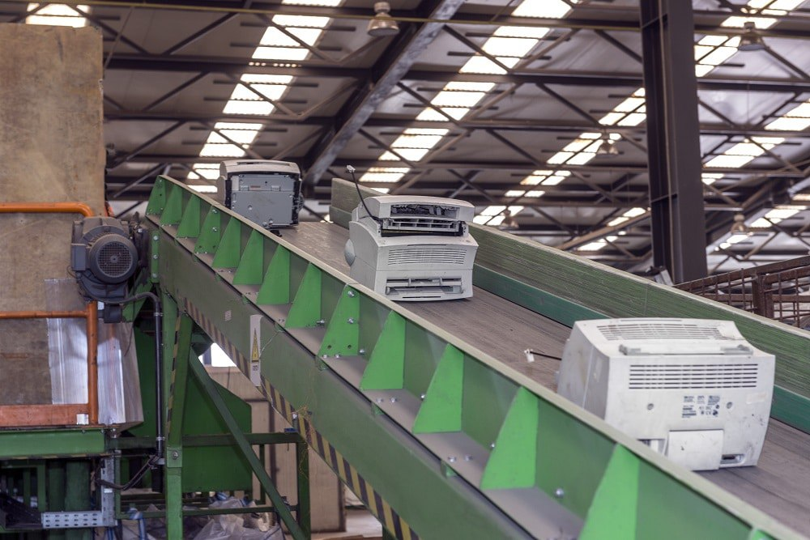
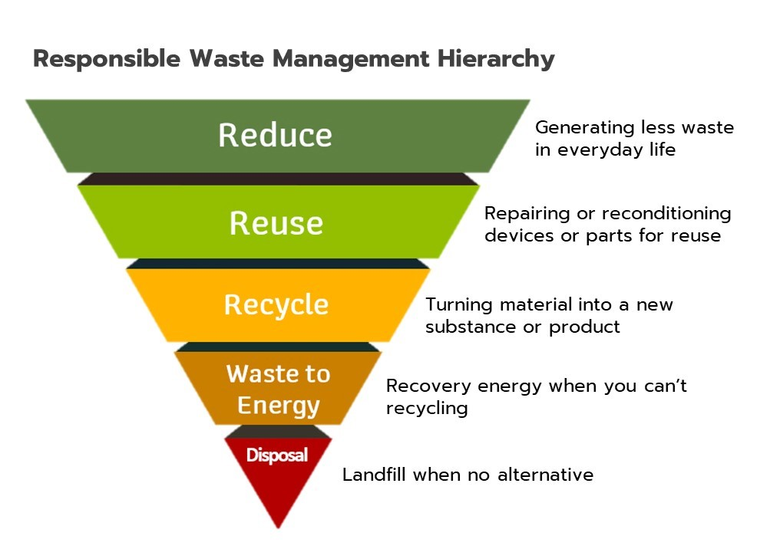
10. E-WASTE MANAGEMENT
In industries management of E-Waste should begin at the point of generation. Waste minimization and sustainable product design involves
Inventory Management
Production process modification
Volume reduction
Recovery and reuse

Slide 25
11. CONCLUSION
The future scenario has, indeed, presented both challenges and opportunities in terms of minimizing wants, managing e-waste as well as developing cleaner and more sustainable products.
Awareness is a good way to begin resolving or attending to the problem.
Let’s make a change for a better future.

Slide 26
12. REFERENCES
https://edgearticles.com/2018/10/04/short-essay-on-e-waste/
https://en.wikipedia.org/wiki/Electronic_waste
https://sites.google.com/site/ewaste306001/conclusion
https://rajyasabha.nic.in/rsnew/publication_electronic/E-Waste_in_india.pdf
https://www.britannica.com/technology/electronic-waste

Slide 27


ANY
QUESTI N

Slide 28



